Slide 1
Project X Data Flow
Content Data
Articles
Infographics
Videos
Courses
Profile Data
Recommendation
Engine
S&D/EMSI Data
Job Data

Slide 2
Questions to Consider
EMSI Data normalized to Onet Data – how best to do in providing relevant EMSI data recommendations based on onet profile?

Slide 3
Current Profile Data Fields
Current Profile Fields:
(Career Guide)
Past Work Experience
Current Job Skills
New Career Options (Desired Career)
Education
Current Location
Min Salary
Max Salary
Job Matching Considerations
Current Profile Fields Collected:
(ResPro)
First Name:
Middle Initial:
Last Name:
Address: (street, city, state, zip)
Phone Number:
Mobile Number:
Current employment status
Job Phase
Employment Industry Interests (drop down)
3 Desired Job Titles (drop down)
Skill Rating
Work Experience
Education History
Awards and Honors
Tools and Technology Skills
Publications
Affiliations
Volunteer Work

Slide 4
Jobs & S&D Data Fields
Job Data:
Country
Job Title
Job Category
Industry
Address
Job Description (open text box)
Job Recommendations
Job Skills (open text box)
Employee Type
Minimum Experience Required
Maximum Experience Required
Degree Required
Travel Required
Compensation (if entered)
Hourly
Annual
Bonus
Commission
S&D Data:
Geography
Company name
Industry
Keywords related to specific skills (I need to dig into this)
Job title
Certification
Education

Slide 5
Content Data Fields

Slide 6
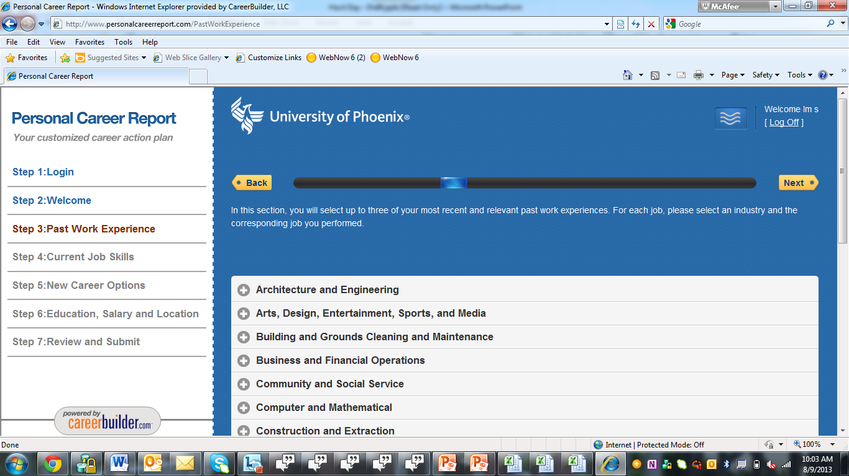
Output Sample (CG)

